Slide 1
Linear Algebra

Slide 2
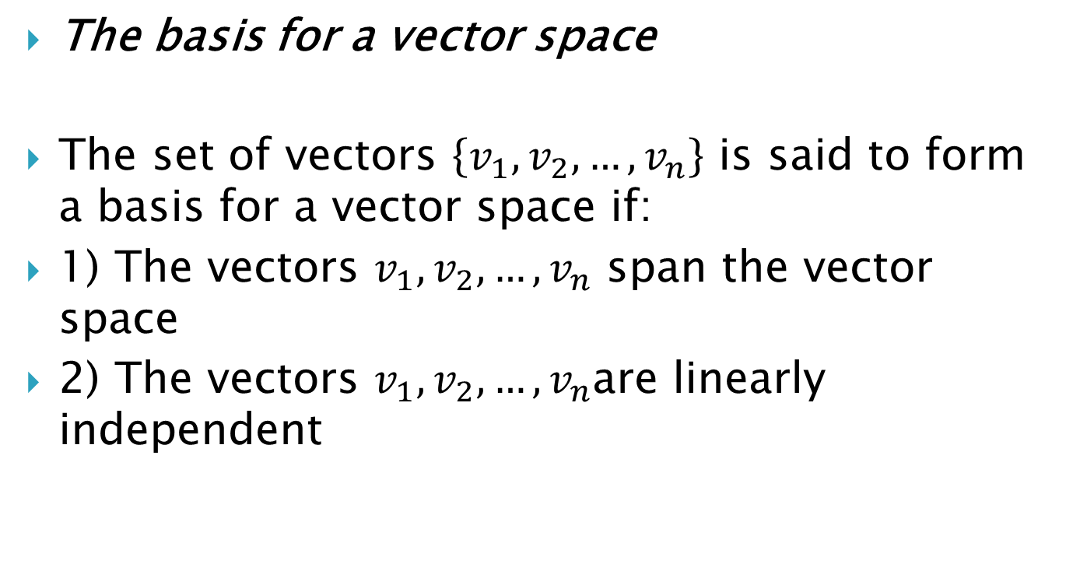
The basis for a vector space
The set of vectors $\left\{v_{1}, v_{2},…, v_{n}\right\}$ is said to form a basis for a vector space if:
1) The vectors $v_{1}, v_{2},…, v_{n}$ span the vector space
2) The vectors $v_{1}, v_{2},…, v_{n}$are linearly independent

Slide 3
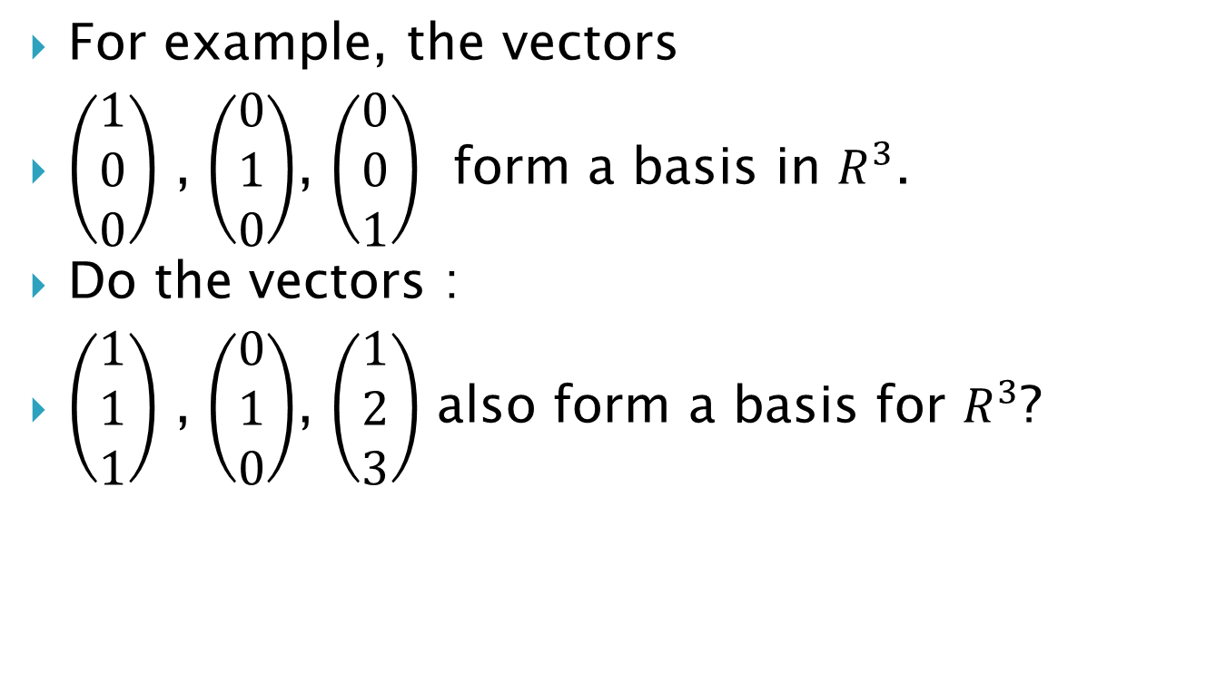
For example, the vectors
$\left(\begin{matrix}1 \\ 0 \\ 0\end{matrix}\right)$ , $\left(\begin{matrix}0 \\ 1 \\ 0\end{matrix}\right)$, $\left(\begin{matrix}0 \\ 0 \\ 1\end{matrix}\right)$ form a basis in $R^{3}$.
Do the vectors :
$\left(\begin{matrix}1 \\ 1 \\ 1\end{matrix}\right)$ , $\left(\begin{matrix}0 \\ 1 \\ 0\end{matrix}\right)$, $\left(\begin{matrix}1 \\ 2 \\ 3\end{matrix}\right)$ also form a basis for $R^{3}$?

Slide 4
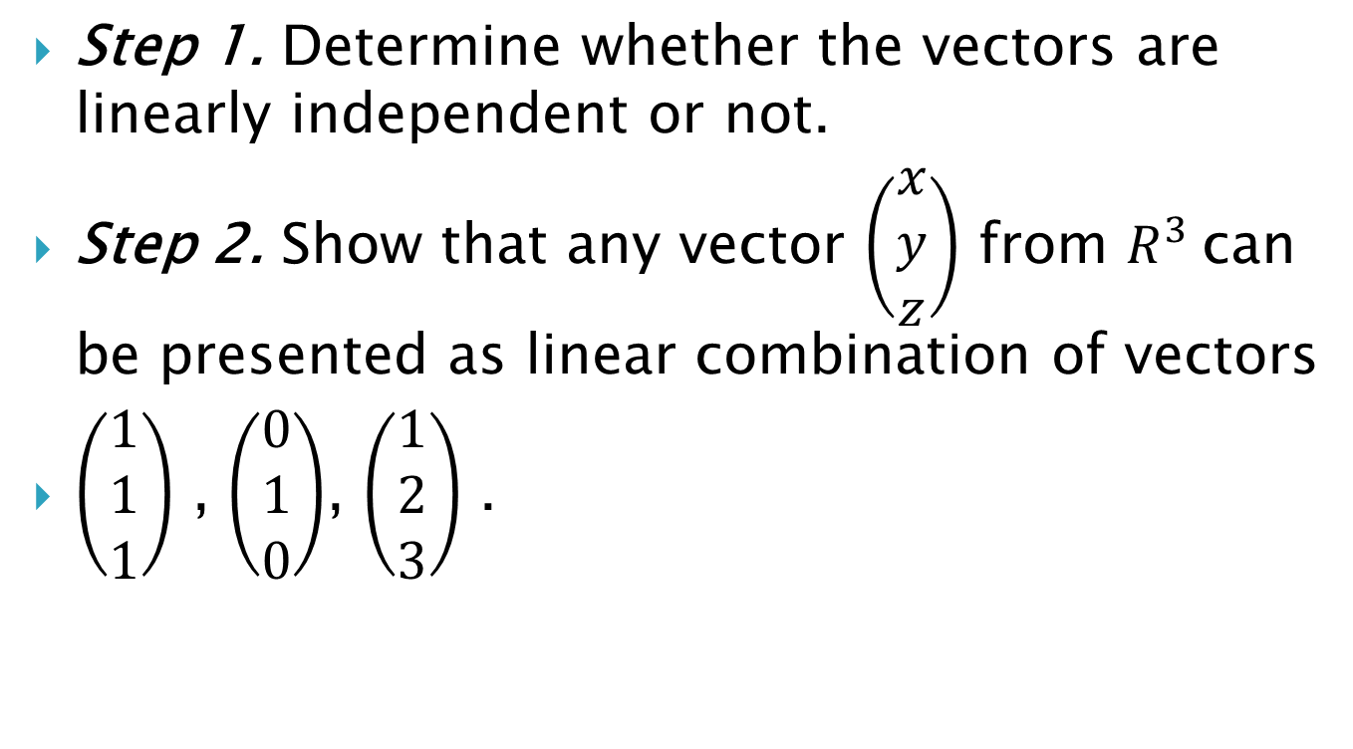
Step 1. Determine whether the vectors are linearly independent or not.
Step 2. Show that any vector $\left(\begin{matrix}x \\ y \\ z\end{matrix}\right)$ from $R^{3}$can be presented as linear combination of vectors
$\left(\begin{matrix}1 \\ 1 \\ 1\end{matrix}\right)$ , $\left(\begin{matrix}0 \\ 1 \\ 0\end{matrix}\right)$, $\left(\begin{matrix}1 \\ 2 \\ 3\end{matrix}\right)$ .

Slide 5
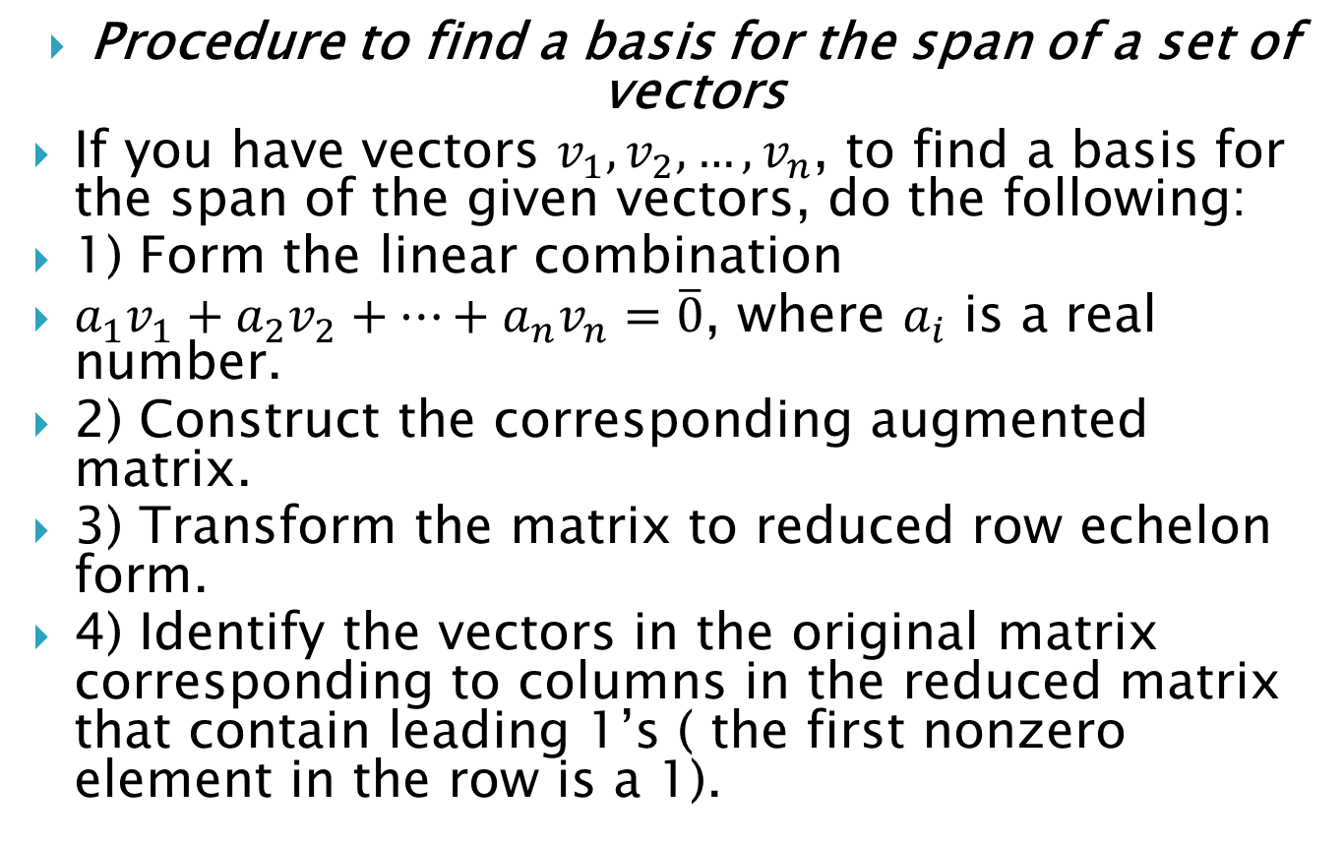
Procedure to find a basis for the span of a set of vectors
If you have vectors $v_{1}, v_{2},…, v_{n}$, to find a basis for the span of the given vectors, do the following:
1) Form the linear combination
$a_{1}v_{1}+a_{2}v_{2}+…+a_{n}v_{n}=\overline{0}$, where $a_{i}$ is a real number.
2) Construct the corresponding augmented matrix.
3) Transform the matrix to reduced row echelon form.
4) Identify the vectors in the original matrix corresponding to columns in the reduced matrix that contain leading 1’s ( the first nonzero element in the row is a 1).

Slide 6
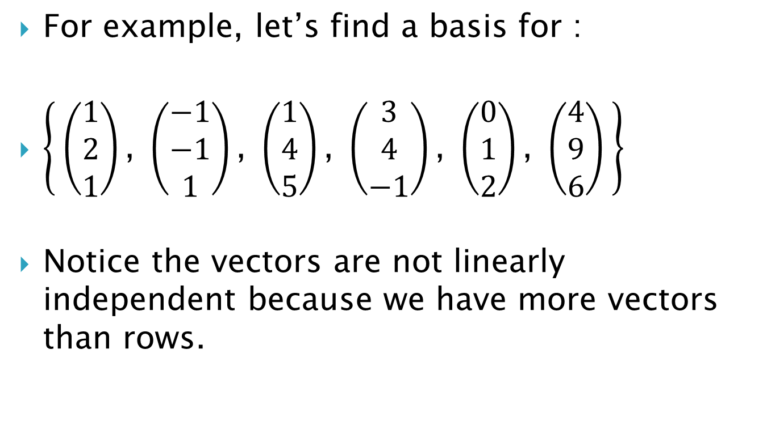
For example, let’s find a basis for :
$\left\{ \left(\begin{matrix}1 \\ 2 \\ 1\end{matrix}\right)\text{, }\left(\begin{matrix}−1 \\ −1 \\ 1\end{matrix}\right)\text{, }\left(\begin{matrix}1 \\ 4 \\ 5\end{matrix}\right)\text{, }\left(\begin{matrix}3 \\ 4 \\ −1\end{matrix}\right)\text{, }\left(\begin{matrix}0 \\ 1 \\ 2\end{matrix}\right)\text{, }\left(\begin{matrix}4 \\ 9 \\ 6\end{matrix}\right) \right\}$
Notice the vectors are not linearly independent because we have more vectors than rows.

Slide 7
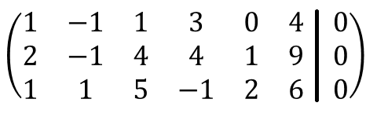
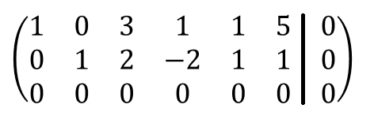
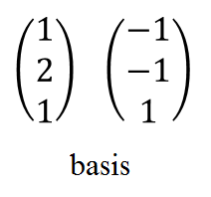

Slide 8
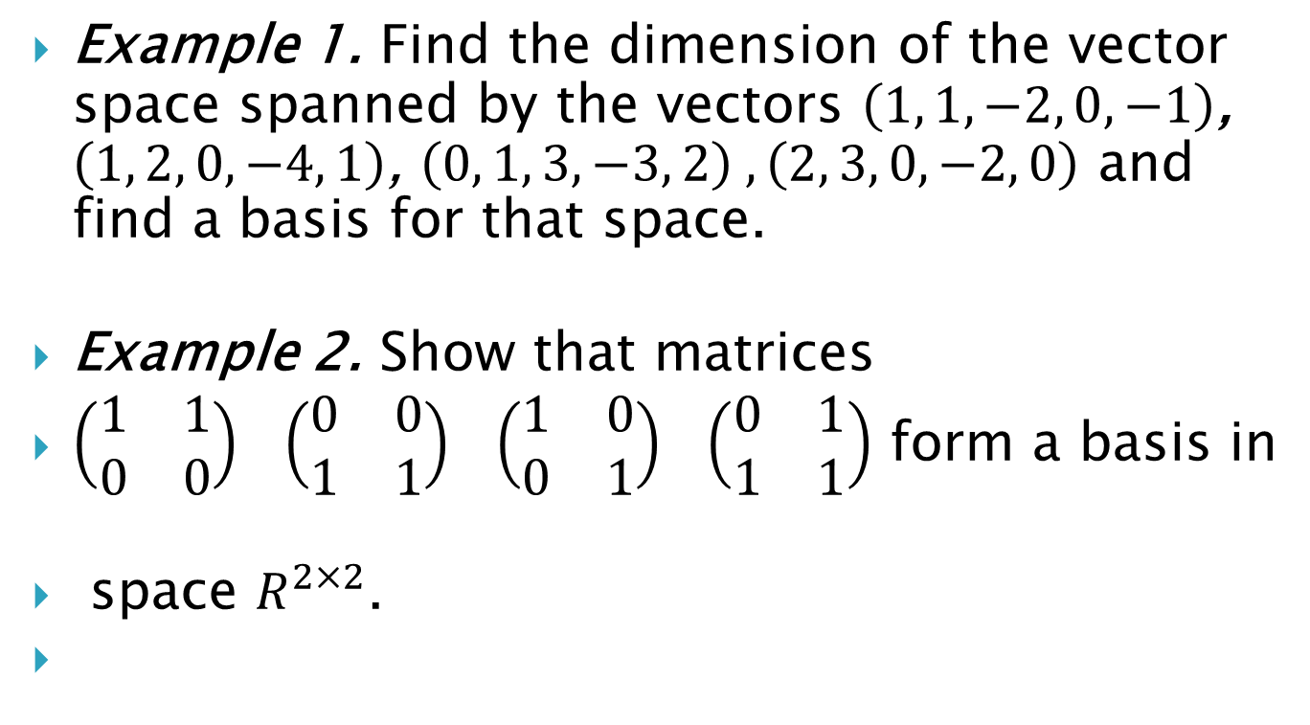
Example 1. Find the dimension of the vector space spanned by the vectors $\left(1, 1, −2, 0, −1\right)$, $\left(1, 2, 0, −4, 1\right)$, $\left(0, 1, 3, −3, 2\right) , \left(2, 3, 0, −2, 0\right)$ and find a basis for that space.
Example 2. Show that matrices
$\left(\begin{matrix}1 & 1 \\ 0 & 0\end{matrix}\right) \left(\begin{matrix}0 & 0 \\ 1 & 1\end{matrix}\right) \left(\begin{matrix}1 & 0 \\ 0 & 1\end{matrix}\right) \left(\begin{matrix}0 & 1 \\ 1 & 1\end{matrix}\right)$ form a basis in
space $R^{2×2}$.

Slide 9
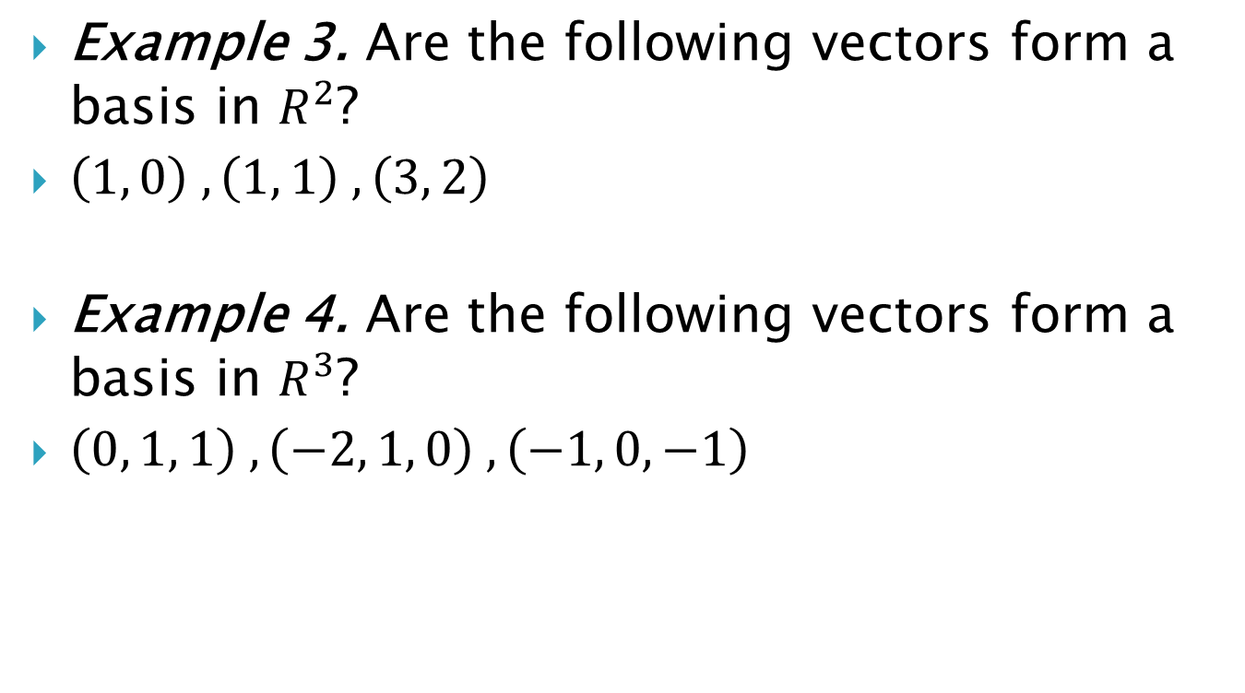
Example 3. Are the following vectors form a basis in $R^{2}$?
$\left(1, 0\right) , \left(1, 1\right) , \left(3, 2\right)$
Example 4. Are the following vectors form a basis in $R^{3}$?
$\left(0, 1, 1\right) , \left(−2, 1, 0\right) , \left(−1, 0, −1\right)$

Slide 10
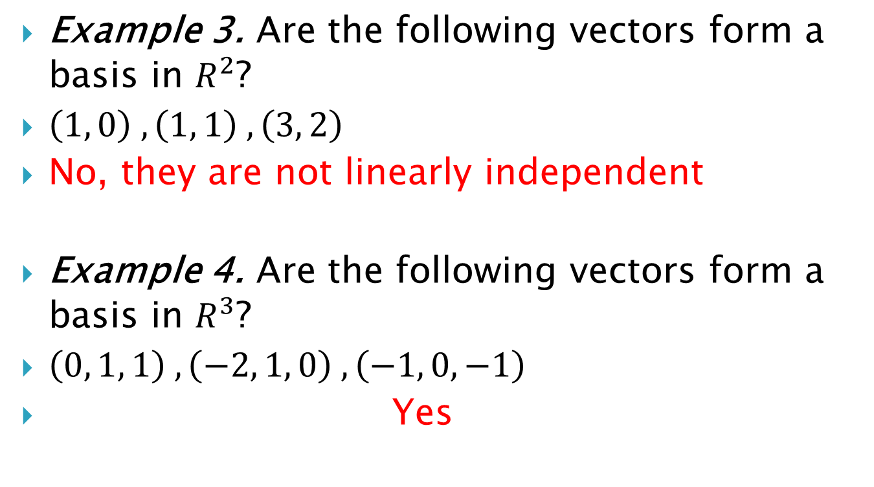
Example 3. Are the following vectors form a basis in $R^{2}$?
$\left(1, 0\right) , \left(1, 1\right) , \left(3, 2\right)$
No, they are not linearly independent
Example 4. Are the following vectors form a basis in $R^{3}$?
$\left(0, 1, 1\right) , \left(−2, 1, 0\right) , \left(−1, 0, −1\right)$
Yes

Slide 11

Example 5. Find a basis and dimension for the subspace
$\left\{ \left(\begin{matrix}1 \\ −4 \\ −3\end{matrix}\right)\text{, }\left(\begin{matrix}−3 \\ 6 \\ 7\end{matrix}\right)\text{, }\left(\begin{matrix}−4 \\ −2 \\ 6\end{matrix}\right)\right\}$

